Slide 1


Alternative Power Strategy

Slide 2




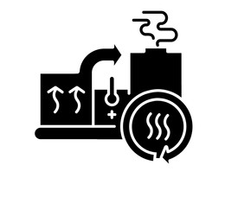

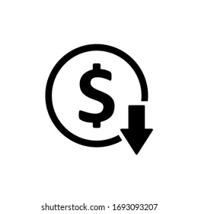

Background
Background
SECMC is currently generating on diesel generator set with an average generation of 6 - 7 MW
Power generation cost from diesel is ~28 USc/kWh
The major load for power generation is dewatering pumps and CHS
To optimize the power generation cost, SECMC has explored various options which are presented in subsequent slides.
Existing Power Scheme
SECMC FOCUS
Options Explored
Installation of additional Solar excluding already installed 5MW
Reliability
Exploring the option of installing battery along with additional Solar for reliable operations and using curtailed renewable energy
Exploring other fuels in place of HSD, which are more commercially viable and readily available
Cost Optimization
14 MW HSD Engines
Existing 5MW Solar
Aux. power from Power Plant or grid connectivity to ensure reliable power supply

Slide 3




Power Solution
Solution – 1
10 MW Rental RFO
Solution – 2
HSD + 10 MW Additional Solar + 6MW Battery
Solution – 3
10 MW Coal
Solution – 4
Grid/Aux. Power from IPPs
5 MW
10 MW (rental)
5+10 MW
6 MW (existing HSD Gensets)
5 MW
10 MW
Pros
Pros
Pros
Pros
Cheaper than the existing solution
Able to ramp accordingly with changing demand during operation
Lead time for Solar is ~9 months
High Renewable Contribution (~47%)
Able to ramp accordingly with changing demand during operation
One of the cheapest options
Coal readily availability
Cheapest of all options
Grid power is consistent and stable.
More economical than independent power systems.
Cons
Cons
Cons
Cons
More expensive than Coal
Low renewable contribution (~24%)
More expensive than Coal and RFO
Unreliable HSD supply given the current conditions
Unable to ramp with major load changes
High GHG emissions
Lead time for coal power plant is ~24 months
Grids can be susceptible to disruptions and load shedding
Energy transport over long distances can lead to losses.
18-20 USc/kWh
Saving of 4 M USD/a
24-26 USc/kWh
Saving of 1 M USD/a
10-13 USc/kWh
Saving of 7 M USD/a
18* USc/kWh
Saving of 5 M USD/a
*The power tariff from the grid may reduce to 6 to 8 Usc/kWh in case of auxiliary power from IPPs
Notes:
RFO cost: 17.46 $/mmbtu, HSD cost: 28.00 $/mmbtu
5MW existing solar already incorporated in load profiling of SECMC
Existing Engine efficiency: 35%, RFO Engine Efficiency: 40%
RFO rental O&M cost: 5.86 USc/kWh
24 MW additional base load considered for expansion
The Capacity Factors are post curtailment on added energy
Coal power plant tariff: 9.5 Usc/kWh

Slide 4

Comparison of Power Solutions
10 MW (rental)
10 MW Output
10 MW
HFO Power Generation
Solar and Battery Storage System
Coal Power Plant
Financially Viable
Lower CAPEX & higher operating cost
Higher CAPEX & lower operating cost
Higher CAPEX & lower operating cost
Project Lead Time
Lead time of around 6 to 9 months
Lead time of around 6 to 9 months
Lead time of around 2.5 to 3 years
Tariff
18 to 20 USc/kWh
15 to 20 Usc/kWh
10 to 13 Usc/kWh
Contract Duration
3 years on BOO Model
15 years on BOO Model
Long term solution on BOO Model
Potential Companies
Technomen Kinetics and Smart Power
HUBCO, multiple vendors
Descon, Izhaar and Technomen kinetics, Etimaad
Short lead time but highest OPEX
Shorter lead time and lower OPEX, though higher than coal
Longest lead time and lowest OPEX, but will require an intermediate solution

